Slide 1
Audieyes: Enhancing Visual Accessibility through Advanced AI Technologies.
Ayoub Maimmadi

Slide 2
Agenda
Introduction
Project Overview
Technical Framework
Implementation Details
Deployment and Operations
Responsible AI Practices
Future Directions & Conclusion

Slide 3

Introduction

Slide 4

Project Overview
Problem Statement
Business Case and Metrics

Slide 5
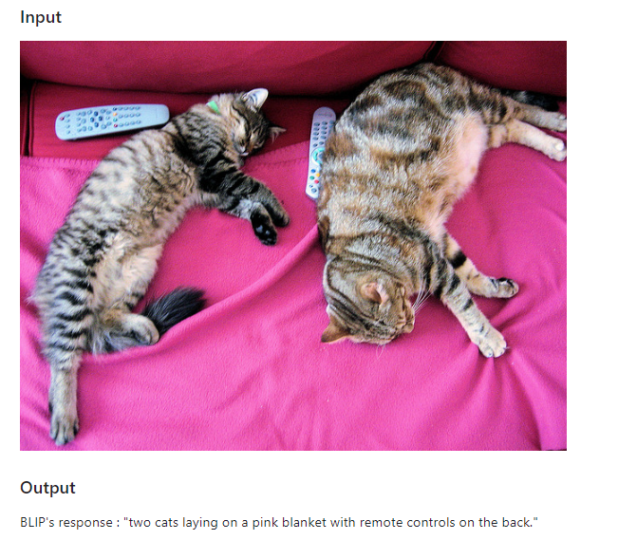
Leveraging machine learning, Audieyes enhances its core functionalities, offering personalized experiences and improving the accuracy and efficiency of its features. ML drives the project's innovative edge, from image recognition to predictive analytics for navigation.

Slide 6
Business Case
Business Metrics
1. Market Expansion:
2. Brand Differentiation.
3. Operational Efficiency:
4. Customer Loyalty and Retention:
5. Data-Driven Insights for Product Development: .
The Audieyes project presents a compelling business case by addressing a critical and underserved market: the accessibility needs of the visually impaired community. Through innovation and user-centric design, Audieyes not only fulfills a social imperative but also taps into a market with significant growth potential.

Slide 7
Implementation Details
ML Pipeline Development
From Monolith to MLOps Pipeline
MLflow for Experiment Tracking
Meta Store Setup
All other technologies
ML System Architecture

Slide 8
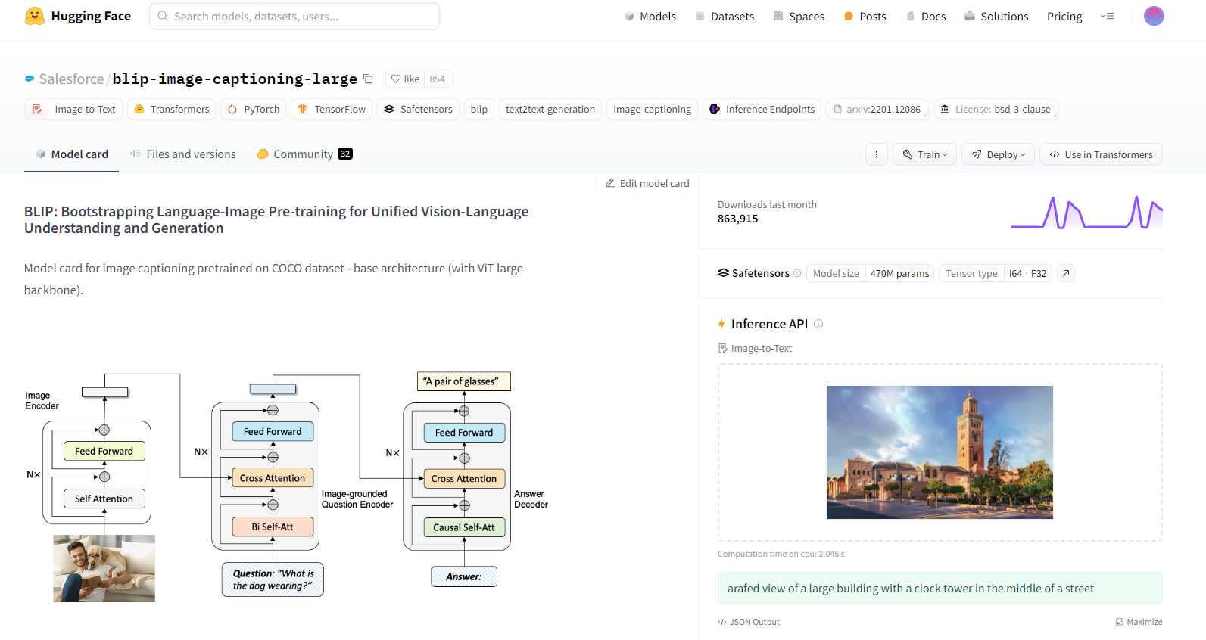

Slide 9
From a Monolith to a Pipeline
Project structure definition and modularity
Code Versioning
Data versioning
Experiment tracking and model versioning
Setting up a meta store for metadata
Setting up the machine learning pipeline

Slide 10

Project structure definition and modularity

Slide 11


Code
Versioning

Slide 12
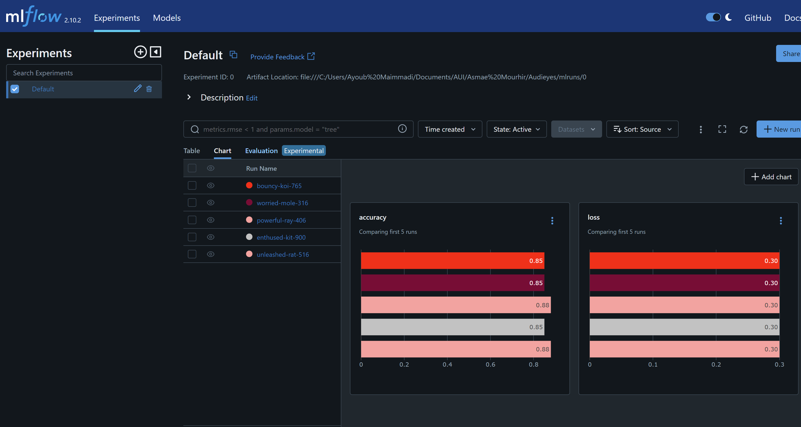
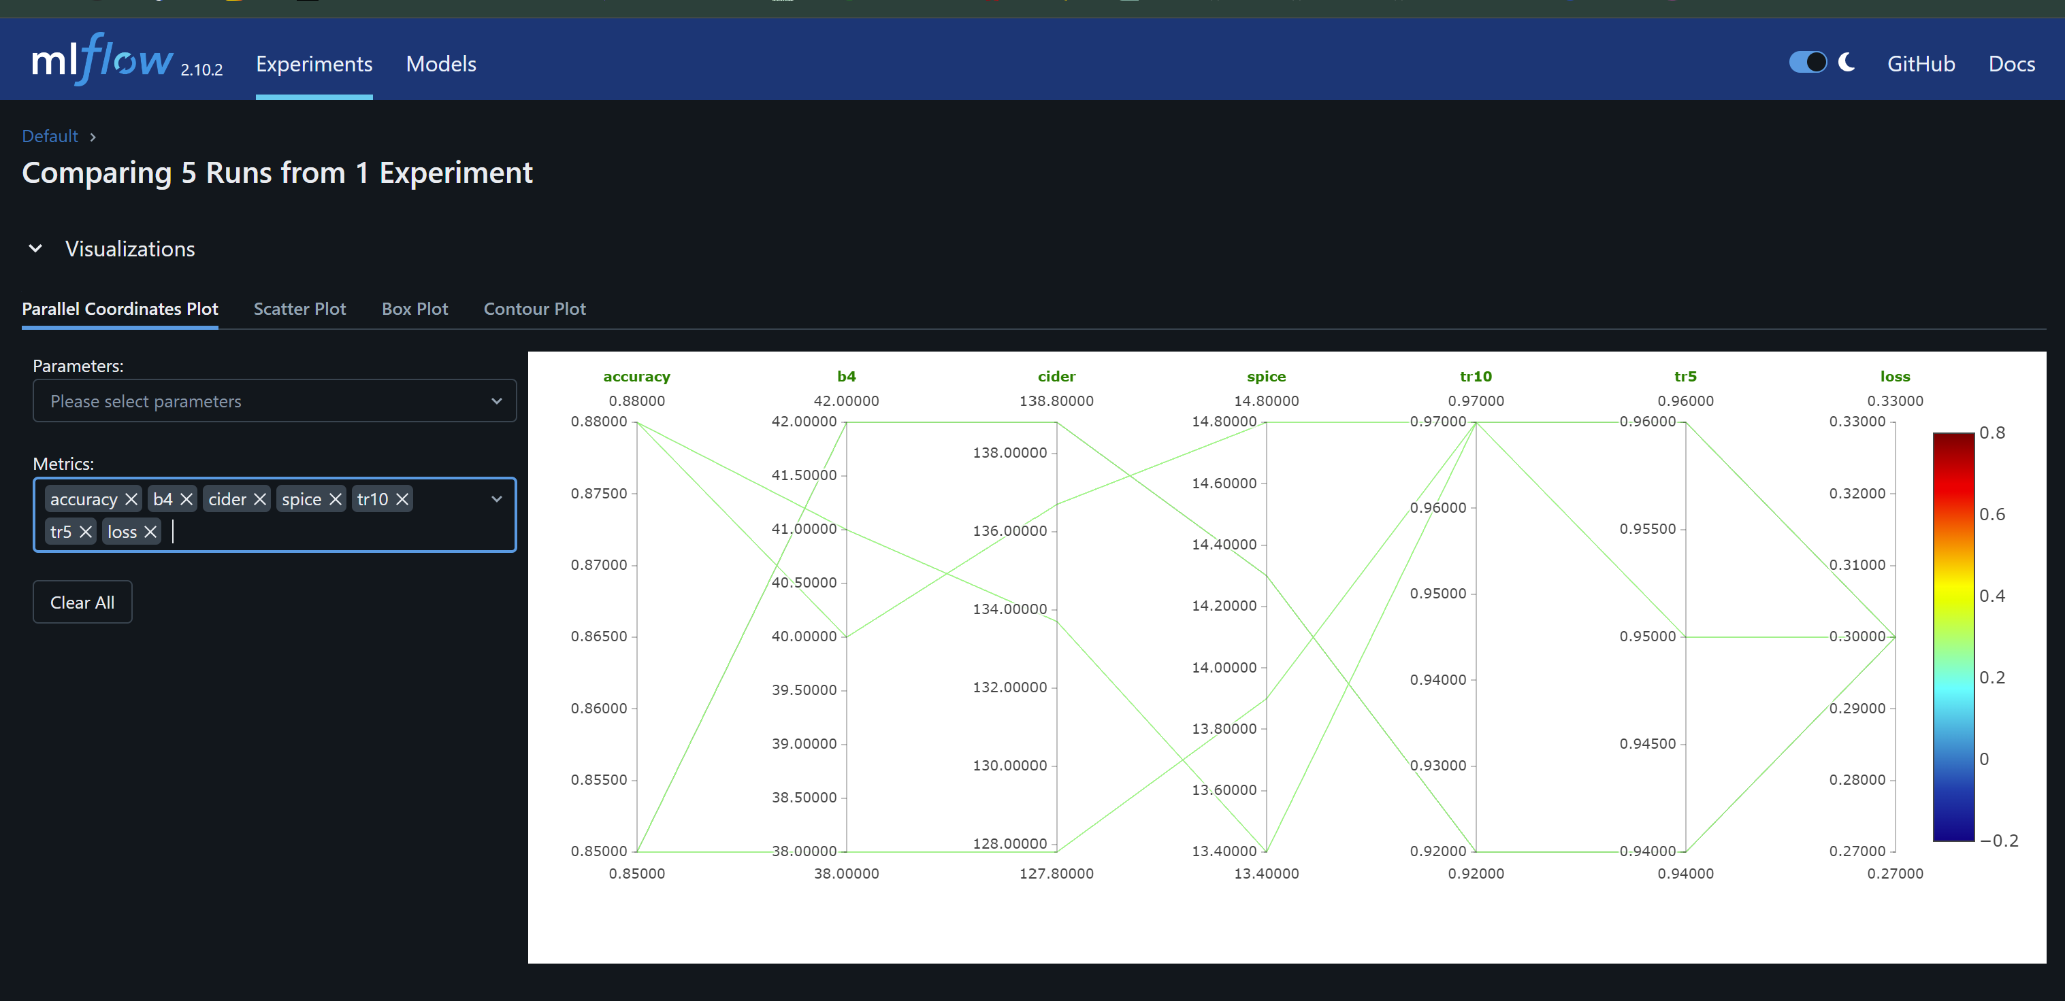
Experiment tracking and model versioning

Slide 13

Setting up a meta store for metadata

Slide 14

Setting up the machine learning pipeline

Slide 15

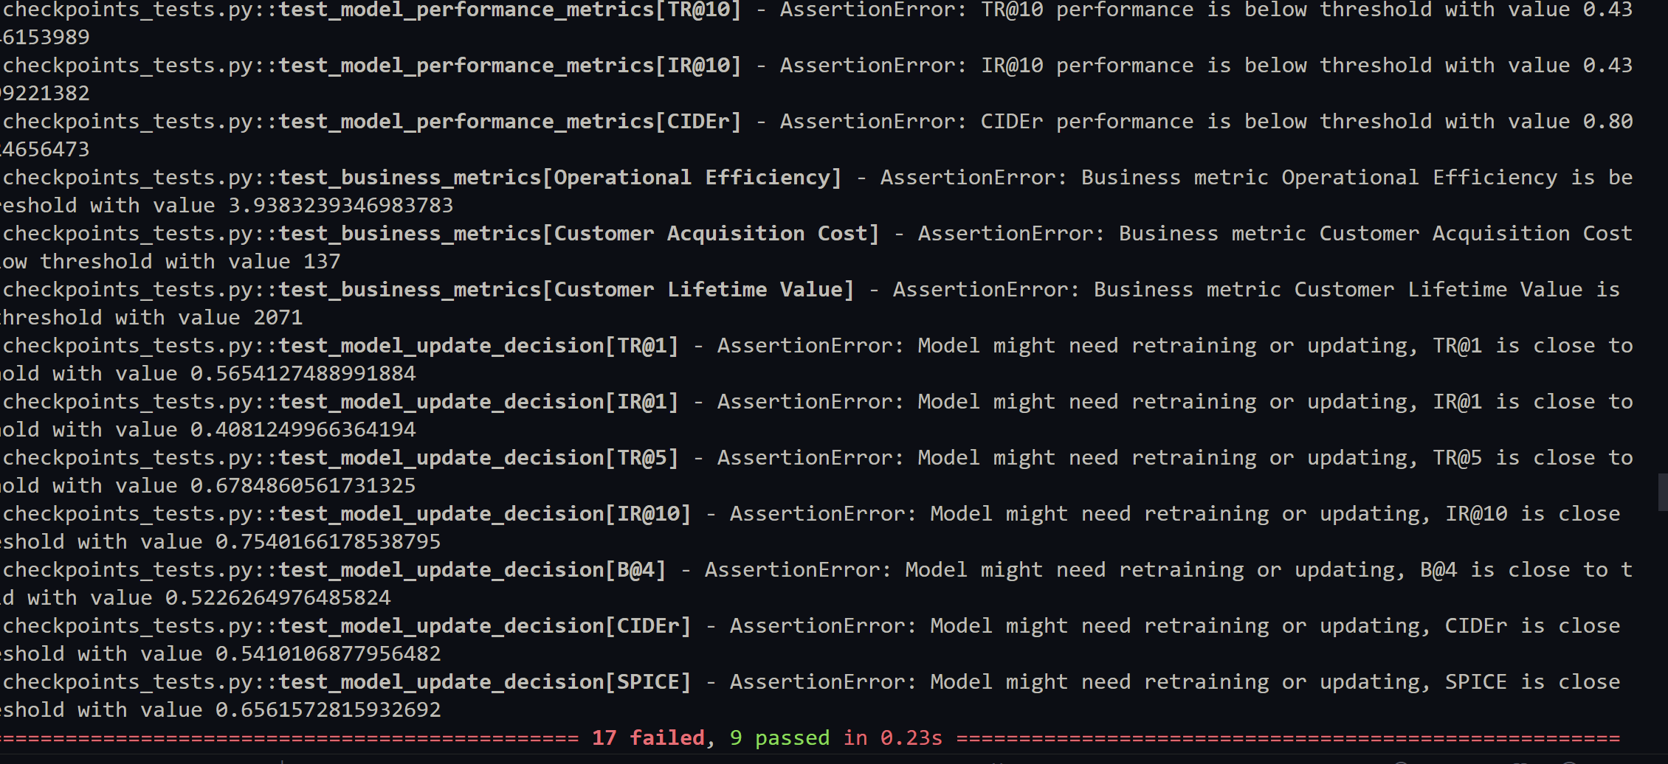
Behavioural model tests

Slide 16

Model monitoring

Slide 17
Deployment and Operations
Service
Model Service Deployment
Client
Front-end Client using React
Strategies
Model Deployment Strategies
Docker, Linode, and Kubernetes

Slide 18

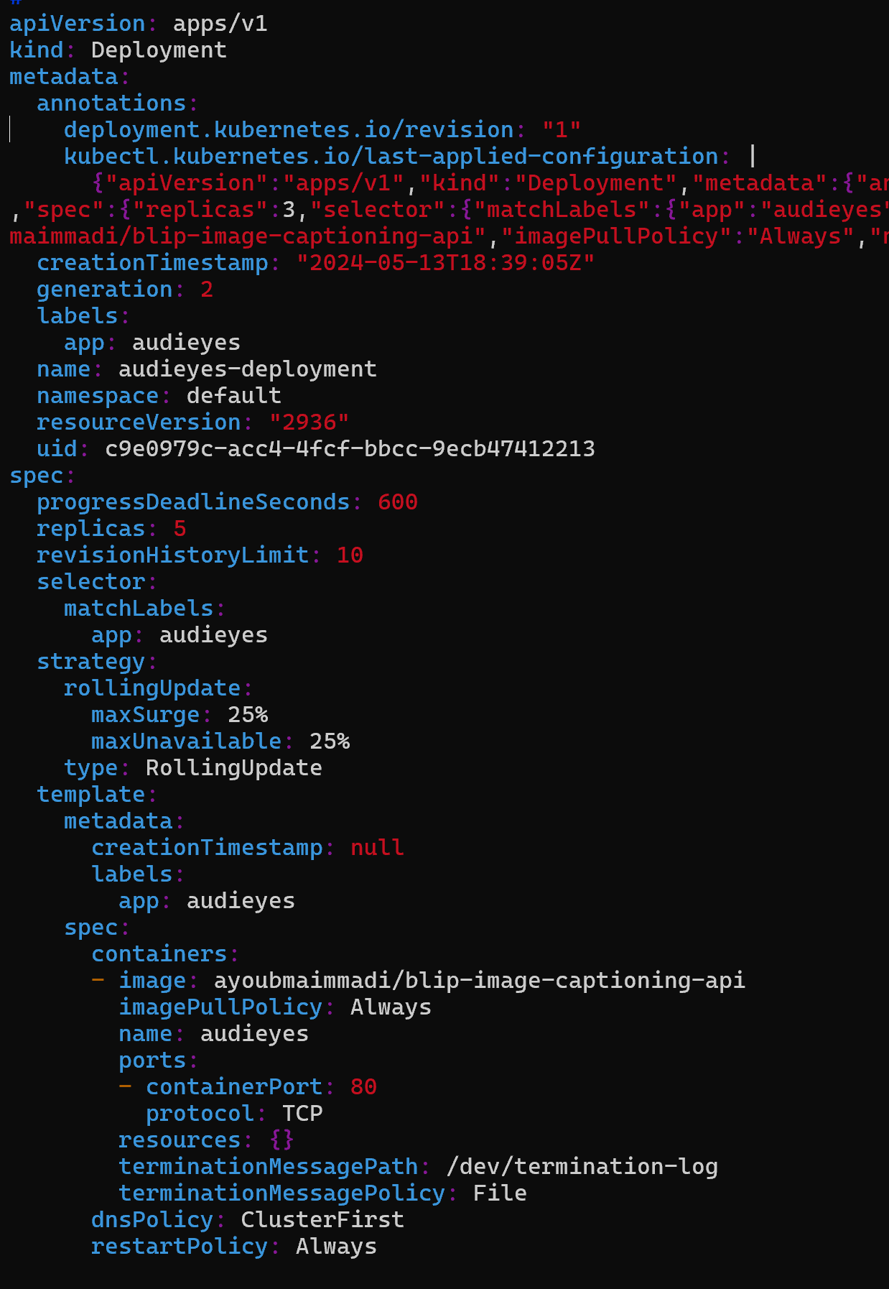
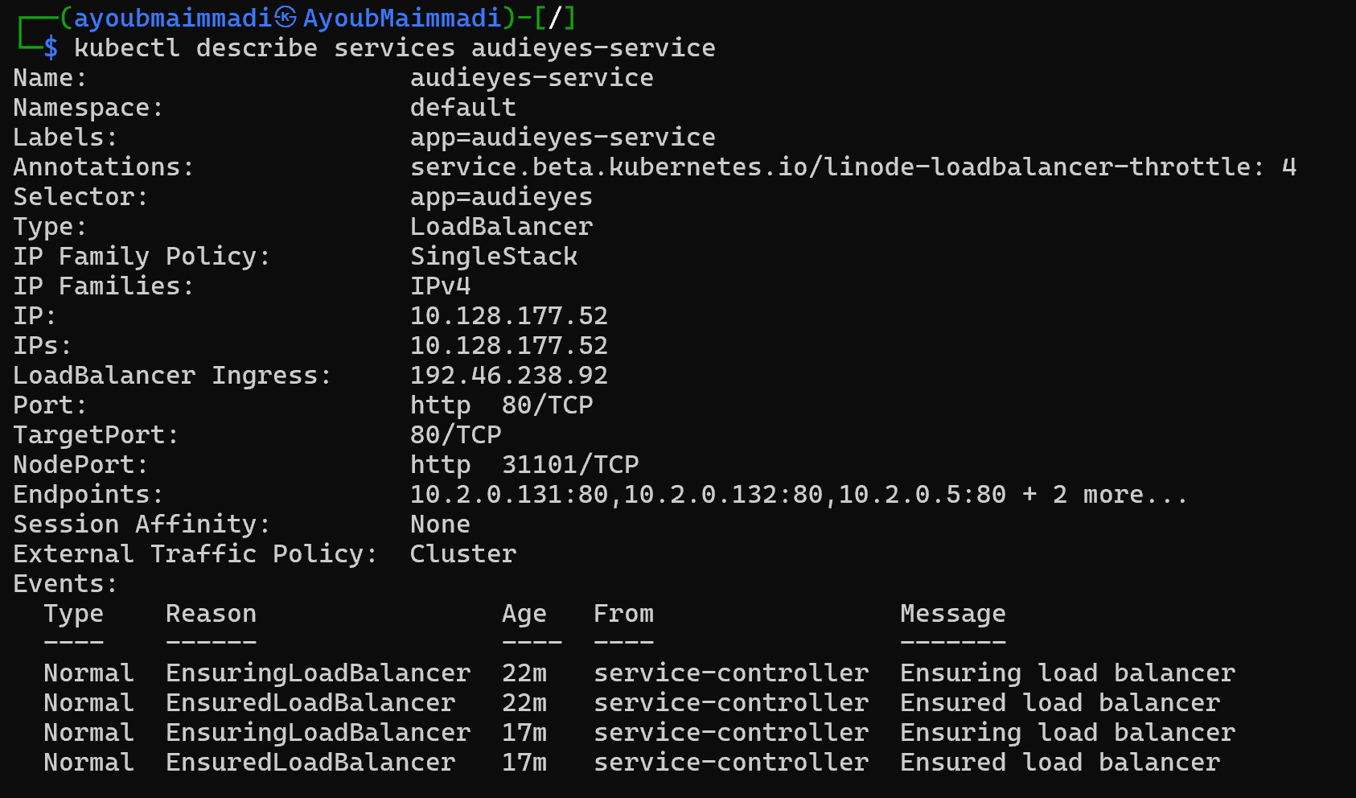
Deployment & serving

Slide 19
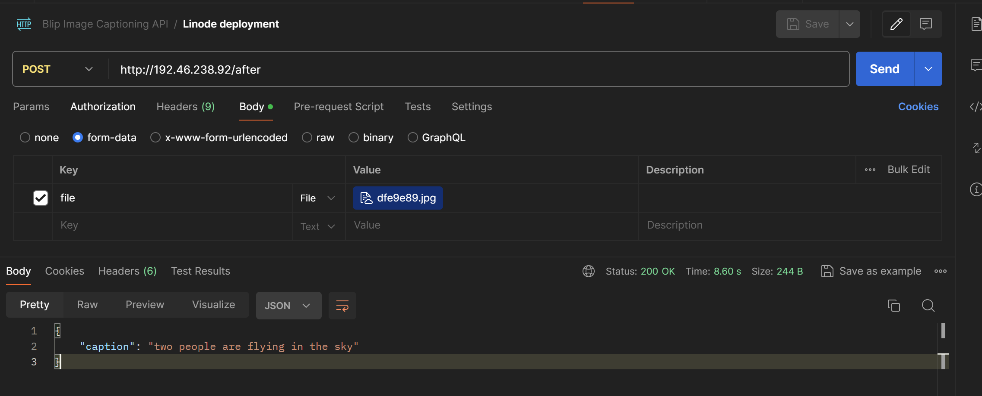
Server

Slide 20
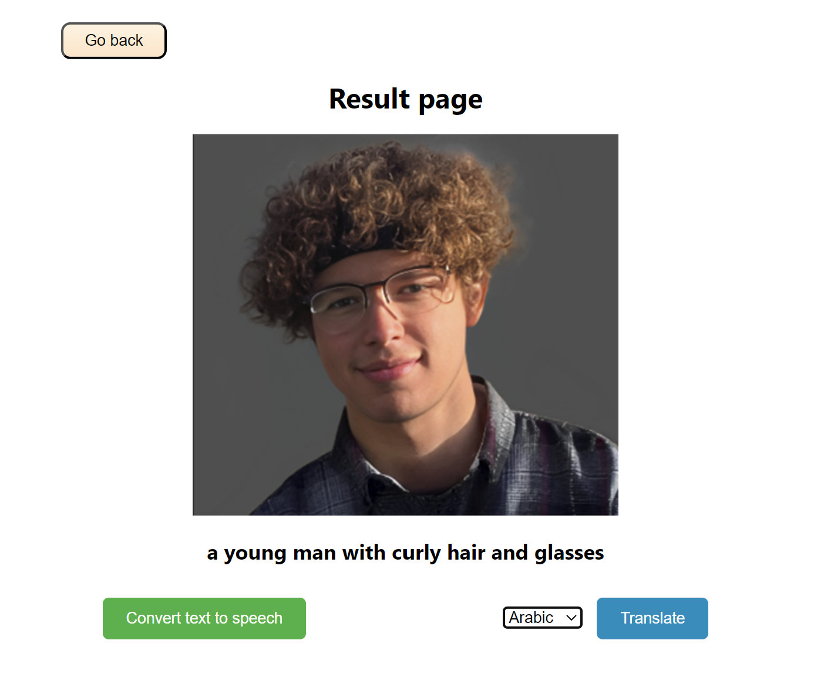
Client

Slide 21


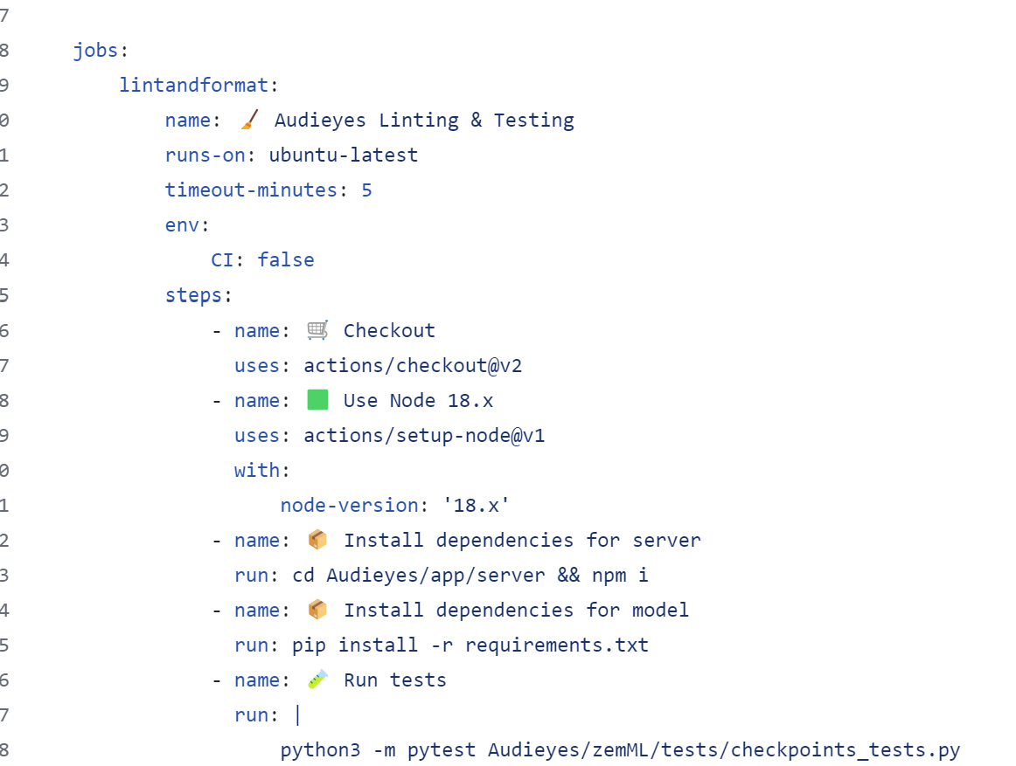
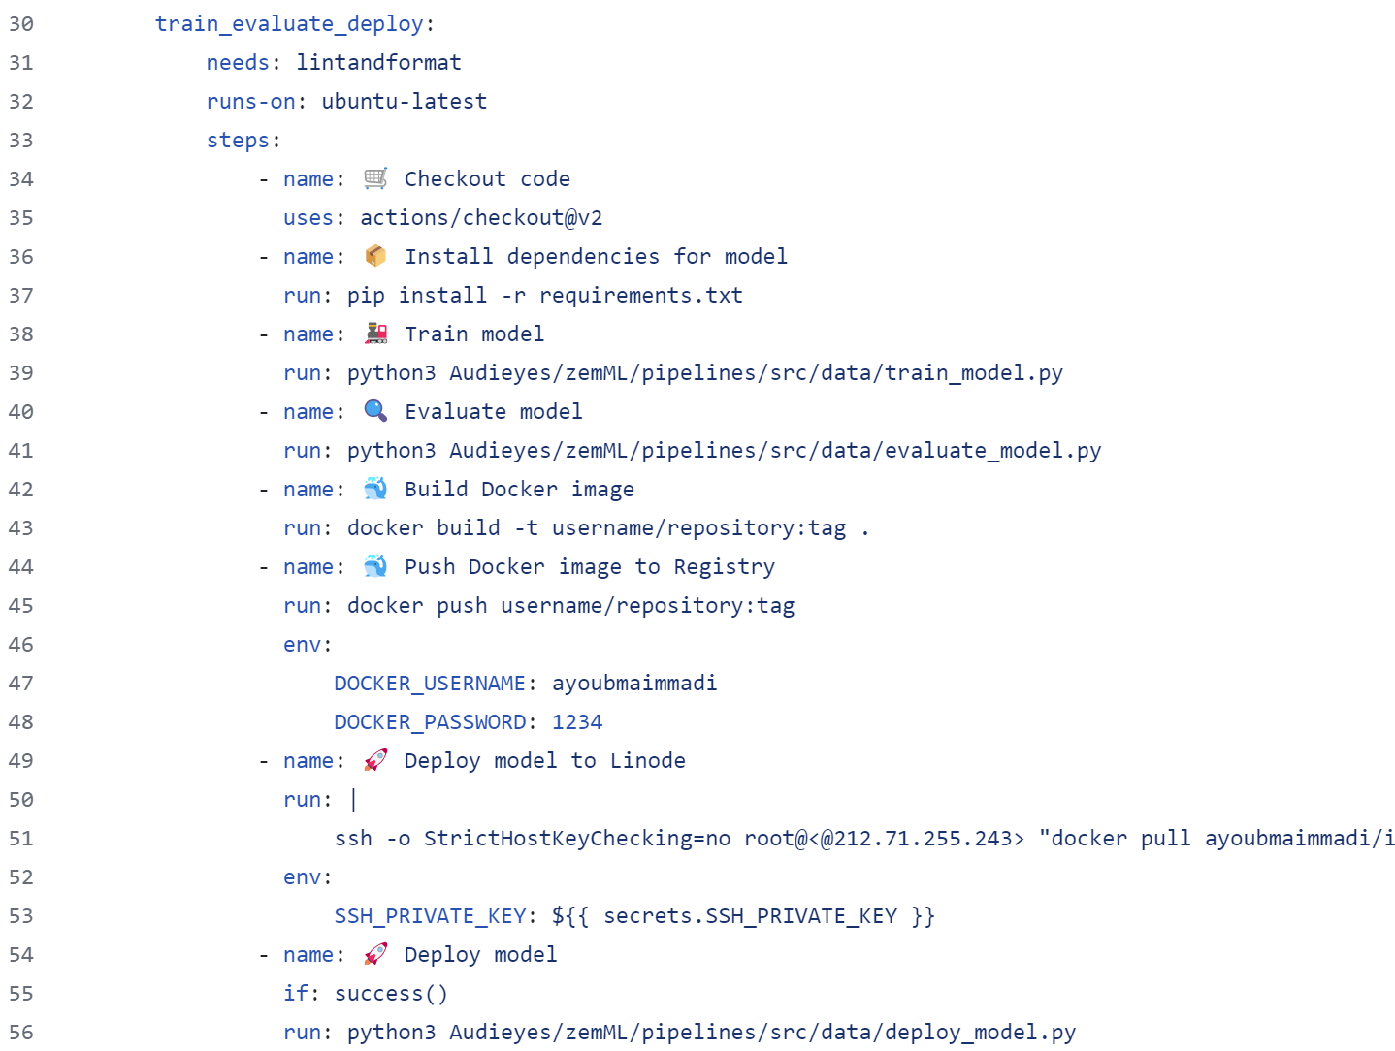
CI/CT/CD pipeline

Slide 22
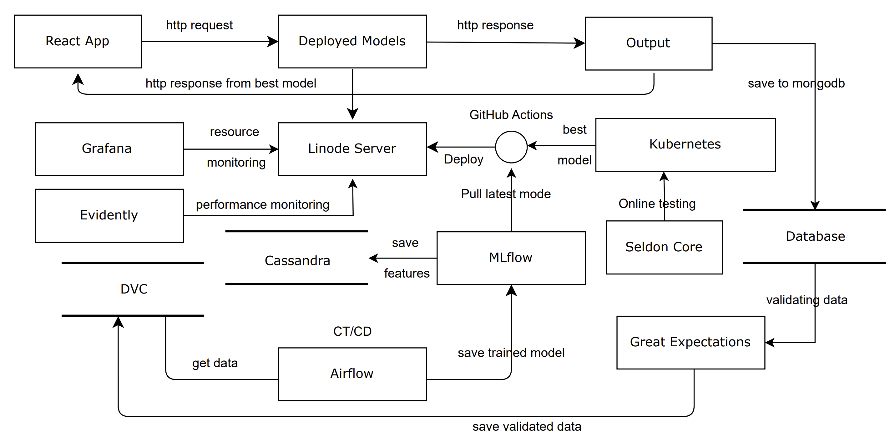
ML system Architecture

Slide 23
Responsible AI
Evaluation Beyond Accuracy
Ensuring fairness and transparency
Notes:
Auditing for Bias: "We proactively audit our AI models for bias. This includes analyzing our training data for diversity, using statistical methods to check fairness across different demographics, and involving independent audits to ensure objectivity."
Ensuring Fairness and Transparency: "To guarantee fairness, we implement algorithms designed to make equitable decisions. For transparency, we use interpretable AI techniques, allowing us to explain our model's decisions clearly. This ensures our users and stakeholders understand and trust how our technology works."
Continuous Improvement: "We are committed to continual improvement, regularly updating our models based on new insights and feedback to meet and exceed ethical standards. This ongoing process ensures that Audieyes remains effective and fair."

Slide 24
Thank you

